Slide 1
Power BI Publishing Content
FSI CSU SWARM

Slide 2
Introduction

Slide 3
Abstract and learning objectives
Understand the methods of publishing Power BI content

Slide 4
Introduction
Publishing Content Introduction

Slide 5
Publishing Content
Publishing Content is a critical part of sharing valuable insights and reports across the organization and beyond.

Slide 6
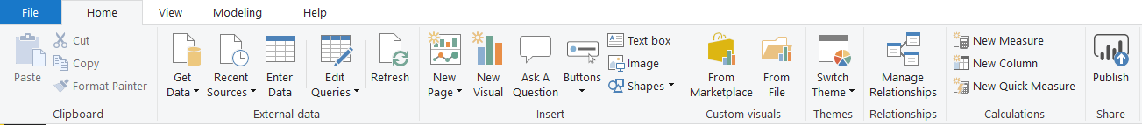
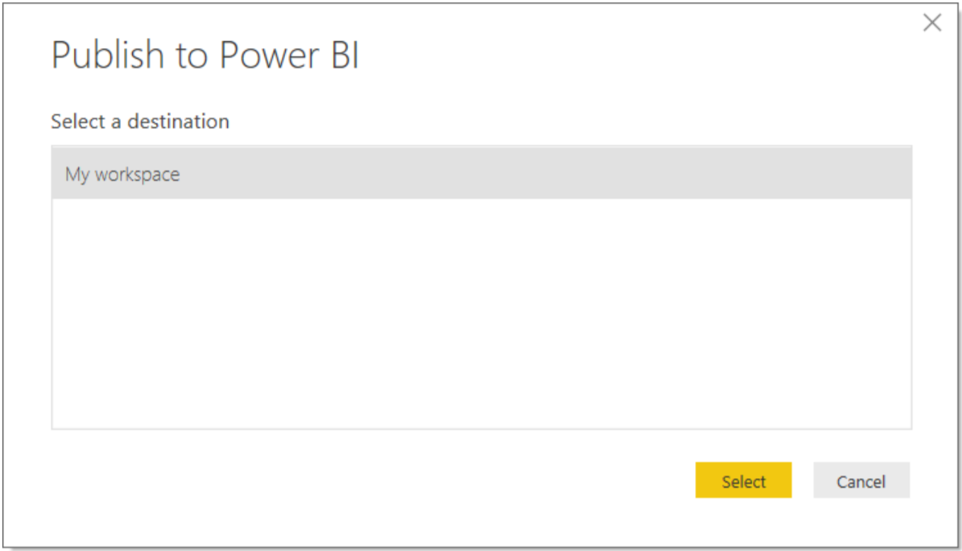
Publishing from Power BI Desktop
Click “Publish” in the Quick Access Ribbon or
In File > Publish > Publish to Power BI
Select Your Destination

Slide 7
Wrap Up

